Slide 1
East Central Iowa and ACEs
Growing a Network for Change

Slide 2
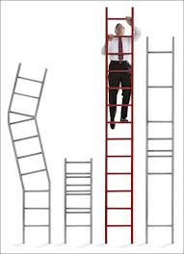
Notes:
The focus of my conversation with you today is “building ladders to success”. How is it that all of us in this room have climbed a ladder to success? Achieved great things. Accomplished great tasks. And why then do others struggle to climb those ladders? I have just enough time today to touch on 3 ideas.
All of us require the same rungs in our ladder in order to be successful.
Our childhood experiences can pull the rungs out of our ladder or strengthen them.
United Way is working with diverse partners across the community and across sectors to strengthen the ladders to success that are available to
our children.
So how did United Way come to be involved in a conversation about education? You may be asking yourself what does a fundraiser have to contribute to this conversation?
We are best known for our fundraising role – last year alone we raised over $10 million dollars which will be distributed to serve 6 counties and over 100k people through the services of 40 community partners. And for almost100 years we funded programs that serve youth all across the community. Those programs focus on everything from developing leadership skills, mentoring, to providing safe out of school time activities for low income youth. It is an important safety net for our children but we have not been able to remove the obstacles to success that our children face every day.
With our partners and local experts, United Way began searching for solutions to these challenges. Our current environment requires that all of us find innovative strategies to achieve the future we desire. In order to do that we have focused on uncovering root causes and building our capacity to respond.

Slide 3
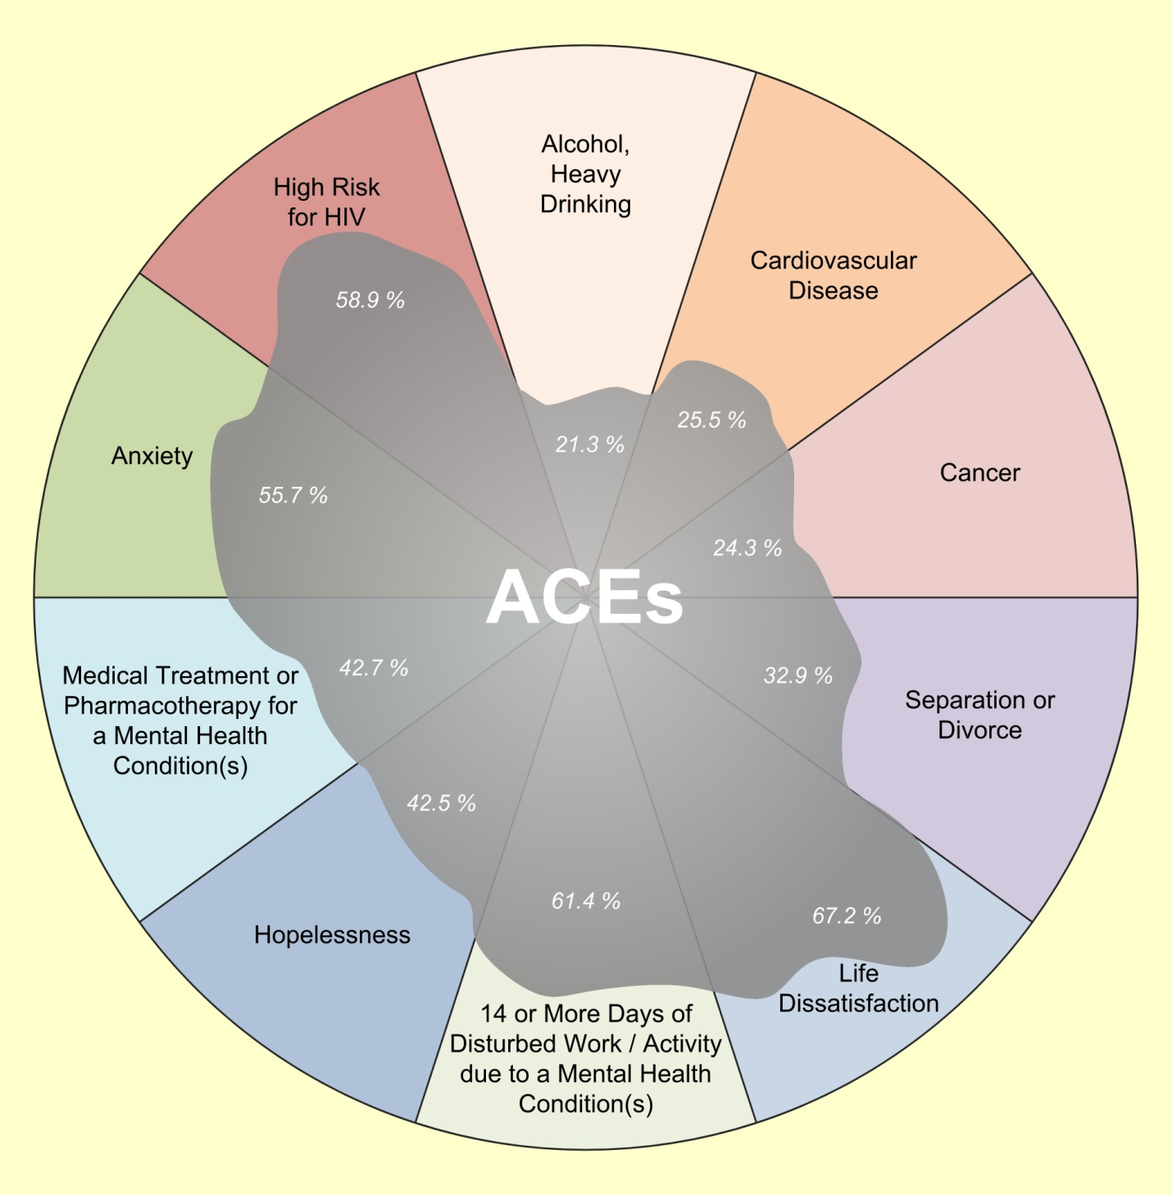
ACE Reduction
Reliably Predicts Improved
Health
Well-being
Productivity
Population Attributable Risk
for ACE –related problems ranges from 20% to 70%
Notes:
The good news is that we live in a state where thousands of people like you are learning about ACEs and working together to protect children and support families. The magnitude of the solution we are working on together is life-changing… literally, for this and future generations.
Let me quickly remind you how to read this slide –
21% of heavy drinking is attributable to ACEs
25% of heart disease is attributable to ACEs
24% of cancer is attributable to ACEs…. And move around this circle with me:
61% of people missing half of their work days in a month due to mental illness is attributable to ACEs – think about it; when was the last time you missed half of the month of work?
43% of mental health condition requiring medical treatment is attributable to ACEs
And almost 60% of risk for HIV is attributable to ACEs.
Working together to prevent the cumulative impacts of ACEs is like placing a sponge in the center of this oil slick of ACEs… as we succeed together in reducing the prevalence of ACEs, we will bring the rates of all these problems down AT ONCE! That is what I mean by the magnitude of the solution. Whether you are working to reduce cancer or HIV, hopelessness or heart disease…. If you do that work, in part, by focusing on preventing ACEs and moderating their effects, your work will have powerful effect on all these problems and many more!

Slide 4
County Health Rankings – Factors of Health
Social & Economic
40%
Health Behaviors
30%
Clinical Care
20%
Education
Alcohol Use
Access to Care
Employment
Diet & Activity
Quality of Care
Income
Tobacco Use
Financial & Social Support
Unsafe Sex
Community Safety
Adverse Childhood Experiences – Underlying Issues
Witnessing Domestic Violence
Crime in Household
Neglect
Abuse
Household member abusing drugs and/or alcohol
Household member with a mental illness

Slide 5
Adverse Childhood Experiences
Neglect
1,059
Abuse
234
Mental Illness in Home
7,924
Drugs and/or Alcohol In Home
6,374
Parental Loss
433
Witnessing Domestic Violence 265
Crime in Household
1,769
United Way of East Central Iowa Investments
Education
Income
Health
Community Corrections Improvement Association
Hawkeye Area Community Action Program
Young Parents Network
Rape Victim Advocacy Program
Waypoint Services
Kids First Law
ASAC
MECCA Services
Abbe Center for Community Mental Health
Families, Inc.
Foundation 2 Crisis Center and Youth Shelter
Horizons: A Family Service Alliance
United Way’s estimated total investment in addressing ACEs = $1,811,382

Slide 6
Explored the Underlying Issues
Environments: Schools, youth development programs
Families: stresses and dysfunctions
Systems of care: policies and practices

Slide 7
Adverse Childhood Experiences Summit, March 2013
Crisis Response & Treatment
Mitigation
Prevention & Early Identification
Notes:
Prevention = Education 70, Screening 23
Mitigation = partnership 32, supportive relationships 26
Crisis response and treatment = TIC 34, and resources 29

Slide 8
Building a Dense Network
Notes:
Learning
Developing our focus
Pursuing measurable outcomes
Choosing to lead

Slide 9
6 Community Conversations
Faith community
Professionals
Community members
Schools
Public and private
Experts and learners
-- in all 40 participants, 26 organizations
Notes:
First Conversation - Invitation
The participants were asked, “What brought you here?”
Common themes included:
Increase awareness of ACES and its impact on long-term health
Develop common language among professionals
Improve identification and referral system to assist with early intervention
Reduce stigma of ACEs
Develop community solutions that address ACEs
Break the cycle and make things better for grandchildren and all kids
Participants were then asked, “What do you hope we will accomplish by having these discussions?”
Common themes included:
Transform the community and reduce the sigma of ACEs through increased awareness and involvement
Create common language and solid base of community ACEs educators
Develop an effective team of community members to collaborate and develop strategies that prevent ACEs
Second Conversation – Possibilities
Participants were asked:
What changes are you wanting to see within our community related to your interest area?
What are the anticipated outcomes of these changes?
Third Conversation - Ownership
Discussed current reality within each of the interest areas.
Identified needed changes.
Homework – go back to your organization and discuss needed changes. Bring back any doubts or reservations.
Commitment conversation. This conversation is about making promises to peers about your contribution to the success. It asks: What promise am I willing to make to this enterprise? And, what price am I willing to pay for success? It is a promise for the sake of a larger purpose, not for personal return.
6) September – Focusing on our community’s strengths in addressing ACEs
Gifts conversation. Rather than focus on deficiencies and weaknesses, we focus on the gifts and assets we bring and capitalize on those to make the best and highest contribution. Confront people with their core gifts that can make the difference and change lives.
October – Final Session
Attendance at an inspirational, culminating, day-long conversation in October or November 2013 with Peter Block to highlight the insights and action you gained and to surface any new possibilities that may have arise.
6th Judicial District Department of Correctional Services (DCS)
Abbe Center
Area Substance Abuse Council
Bridgehaven Pregnancy Support
Catherine McAuley Center
Cedar Rapids Schools
Foundation 2
HACAP
HeartCry Ministries
Horizons
Iowa Legal Aid
Iowa PTA
Juvenile Probation
Kids on Course
Metro High School
Linn County Public Health
Linn County Child and Youth Development Services
Linn County Community Services
Linn County Home Health
Kirkwood Community College
Partnership for Safe Families
St. Luke's Hospital
St. Luke’s Medical Social Services/Center for Women's and Children's Health
Stewards of Children Facilitator/Anamosa Community School District
Tanager Place
United Church of Monticello and volunteer at JMRT/Four Oaks
United Way of East Central Iowa
Waypoint
Young Parents Network

Slide 10
Finding Champions: Education Advisory Team
5 school districts
Media
Business
Grant Wood AEA

Slide 11
Learning and Discovery
March 2013 Adverse Childhood Experiences Summit
April – September 2013 6 ACEs Community Conversations
ACEs Community Awareness and Education Events:
Univ. of Iowa School of Nursing – December 2012
Cedar Rapids Community School District
Marion and CR Downtown Rotary
Linn Community Care – July 2013 Healthy Community Expo
Ready by 21 Stakeholders
Child Abuse and Neglect presentation to Linn County Board of Public Health.
September 2013 - Linn County DECAT, DHS and Juvenile Court ACEs Event

Slide 12
New Priorities:
Social connectedness
Improved functioning

Slide 13
Notes:
Building A High Capacity Community:
All of our ACEs work had an end results of Building a Higher Capacity community based on the Washington State Family Policy Council’s model.
Based on their research:
Rates of mental, behavioral and physical disorders are lower in higher capacity communities among young adults, ages 18-34.
The lower rates of disorders are partly due to reductions in ACEs and increases in social and emotional support associated with higher community capacity among young adults, ages 18-34.
United Way’s Next Steps:
United Way has created a seven year community goal dedicated to increasing social connectedness and improving functioning of low-income families with children over the next seven years.
Prevent Child Abuse Grant:
By Oct. 10th we will know if we are a finalist with the Prevent Child Abuse Grant. If we are successful below is additional info. to include:
Over the next six months, PCA will offer intensive individualized training/coaching to representatives from six counties on how to use The ACE Study to engage community leaders, business professionals, youth-serving organizations, and other targeted audiences in child abuse prevention. Specifically, we will receive training and coaching in the following areas:
The Adverse Childhood Experiences (ACE) Study and the neurobiology of stress
Connecting Iowa’s ACEs data to child abuse prevention strategies and messages
Implementing The Tri-Ethnic Center’s Community Readiness Model
Developing your community engagement and communications strategy
Individualized support in implementing your strategy
Below is a seven month timeline that the Prevent Child Abuse has outlined. I’ve included my comments in red on how it will align with our existing ACEs work and timeline.
Responsibilities Timeline
September 2013
Submit application by October 4; candidates selected by October 10 – I have outlined within my message below how local partners will submit the application. I would be responsible for complete the questions for United Way’s perspective. You would also be involved with providing input.
Oct. 14, 2013
Attend the ACEs Summit (we encourage you to register if you apply) – You, Doug and I and are planning to attend this and you are on the panel discussion.
Nov. 19, 2013
Attend a one-day workshop on the Tri-Ethnic Center’s Community Readiness Model – I am available to attend this training.
Dec.-Feb. 2014
Implement community readiness assessment - This comes in between our grant cycle but which will be busy but I think I can build time into my schedule to make this work since it aligns with our direction with ACEs and building a high capacity community.
February 2014
Complete online learning modules on ACEs and Prevention; receive additional training on the science behind the study - Will build time in my scheduled to accomplish this.
March 2014
Attend a one-day workshop to develop your community engagement and communications plan based on the results of your community readiness assessment – This will align with our ACEs Community Conversations process of checking in with them in six months. We will be able to use their input in developing our ACEs engagement and communications plan.
On-going
Implement your community engagement plan in your region/area – This will align nicely with our timeline for beginning our work by July 1st once the ACEs engagement and communications plan has been developed with our local ACEs Stakeholders.
On-going
Deliver trainings to interested community members.

Slide 14
Hope and Resilience!
Notes:
Along with the 3,815 books delivered last year alone, RED Ahead has shown real improvements in the lives of parents and their children. During the most recent evaluation survey:
93% respondents reported they “feel more prepared to support [their] child’s language development and pre-reading skills”, and
98% of respondents practiced skills learned at RED Ahead at home – bringing the skills they learned into practice every day.
Also, of the children screened for developmental progress, at least 93% improved or maintained skills in all categories.
Children who are screened and found to be lower than the target proficiencies for their age are offered supplemental activities and referrals to assist them.
100% of families participated in supplemental activities when offered
43% accepted referrals when offered
Of the 1,326 families served who have seen these impressive results:
501 are single mothers
167 are homeless
438 have a family monthly income of less than $1,000

